Slide 1


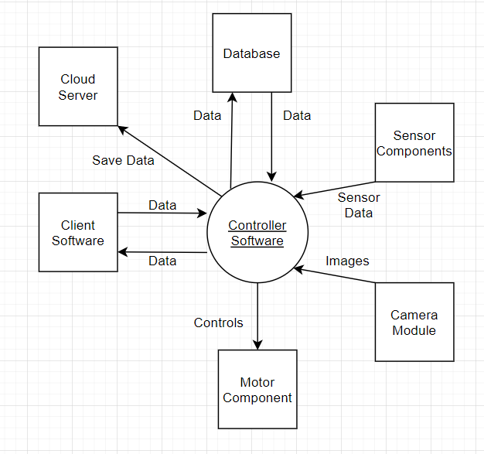
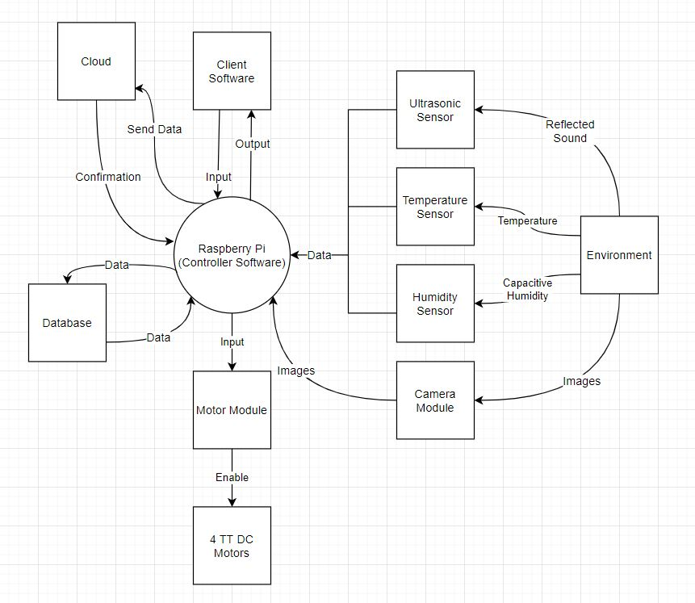
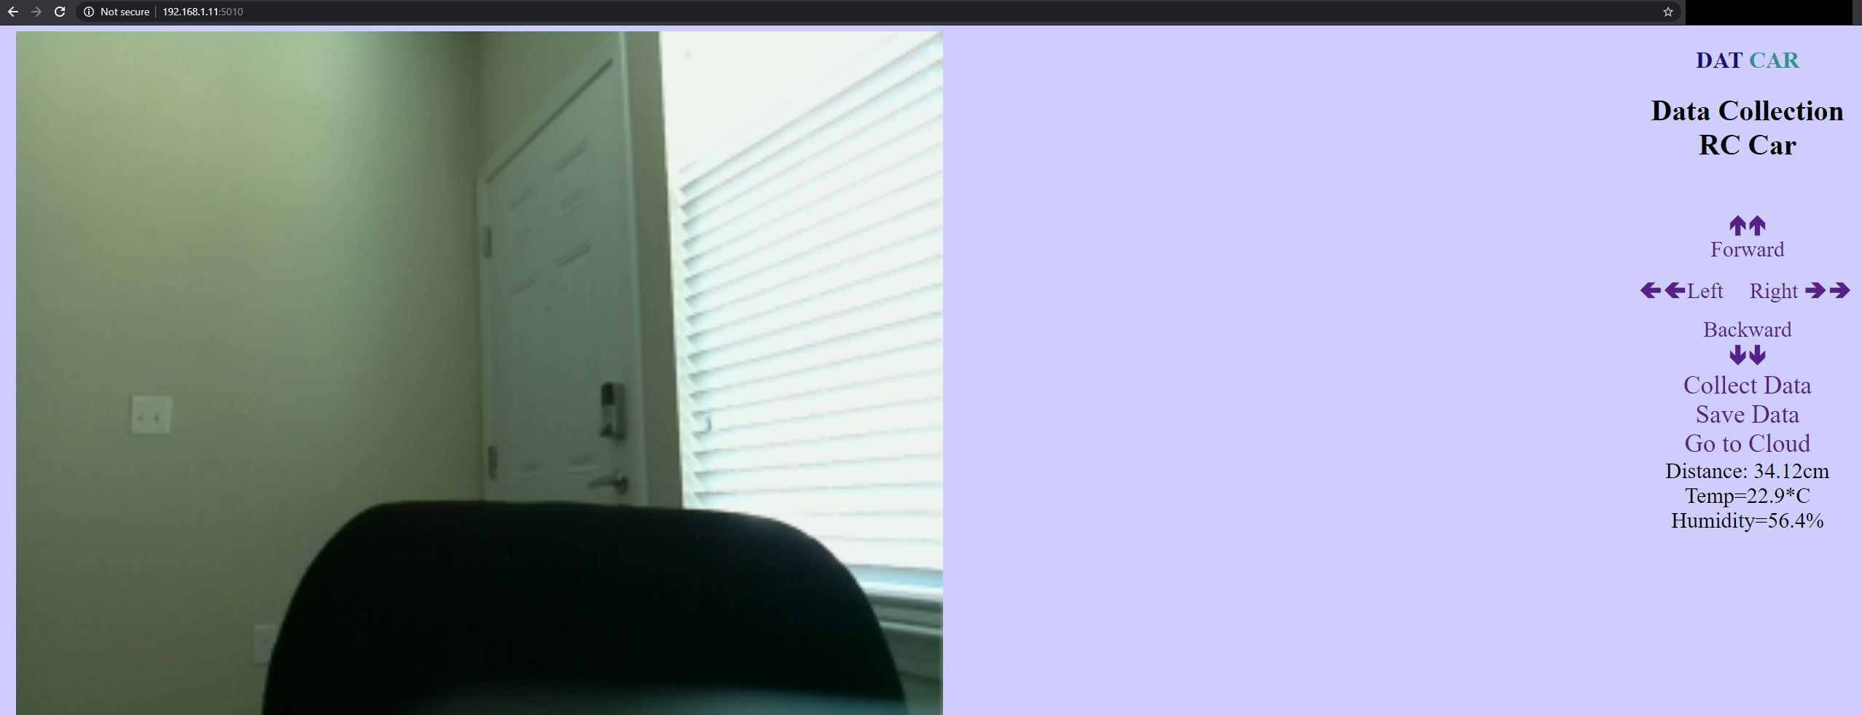
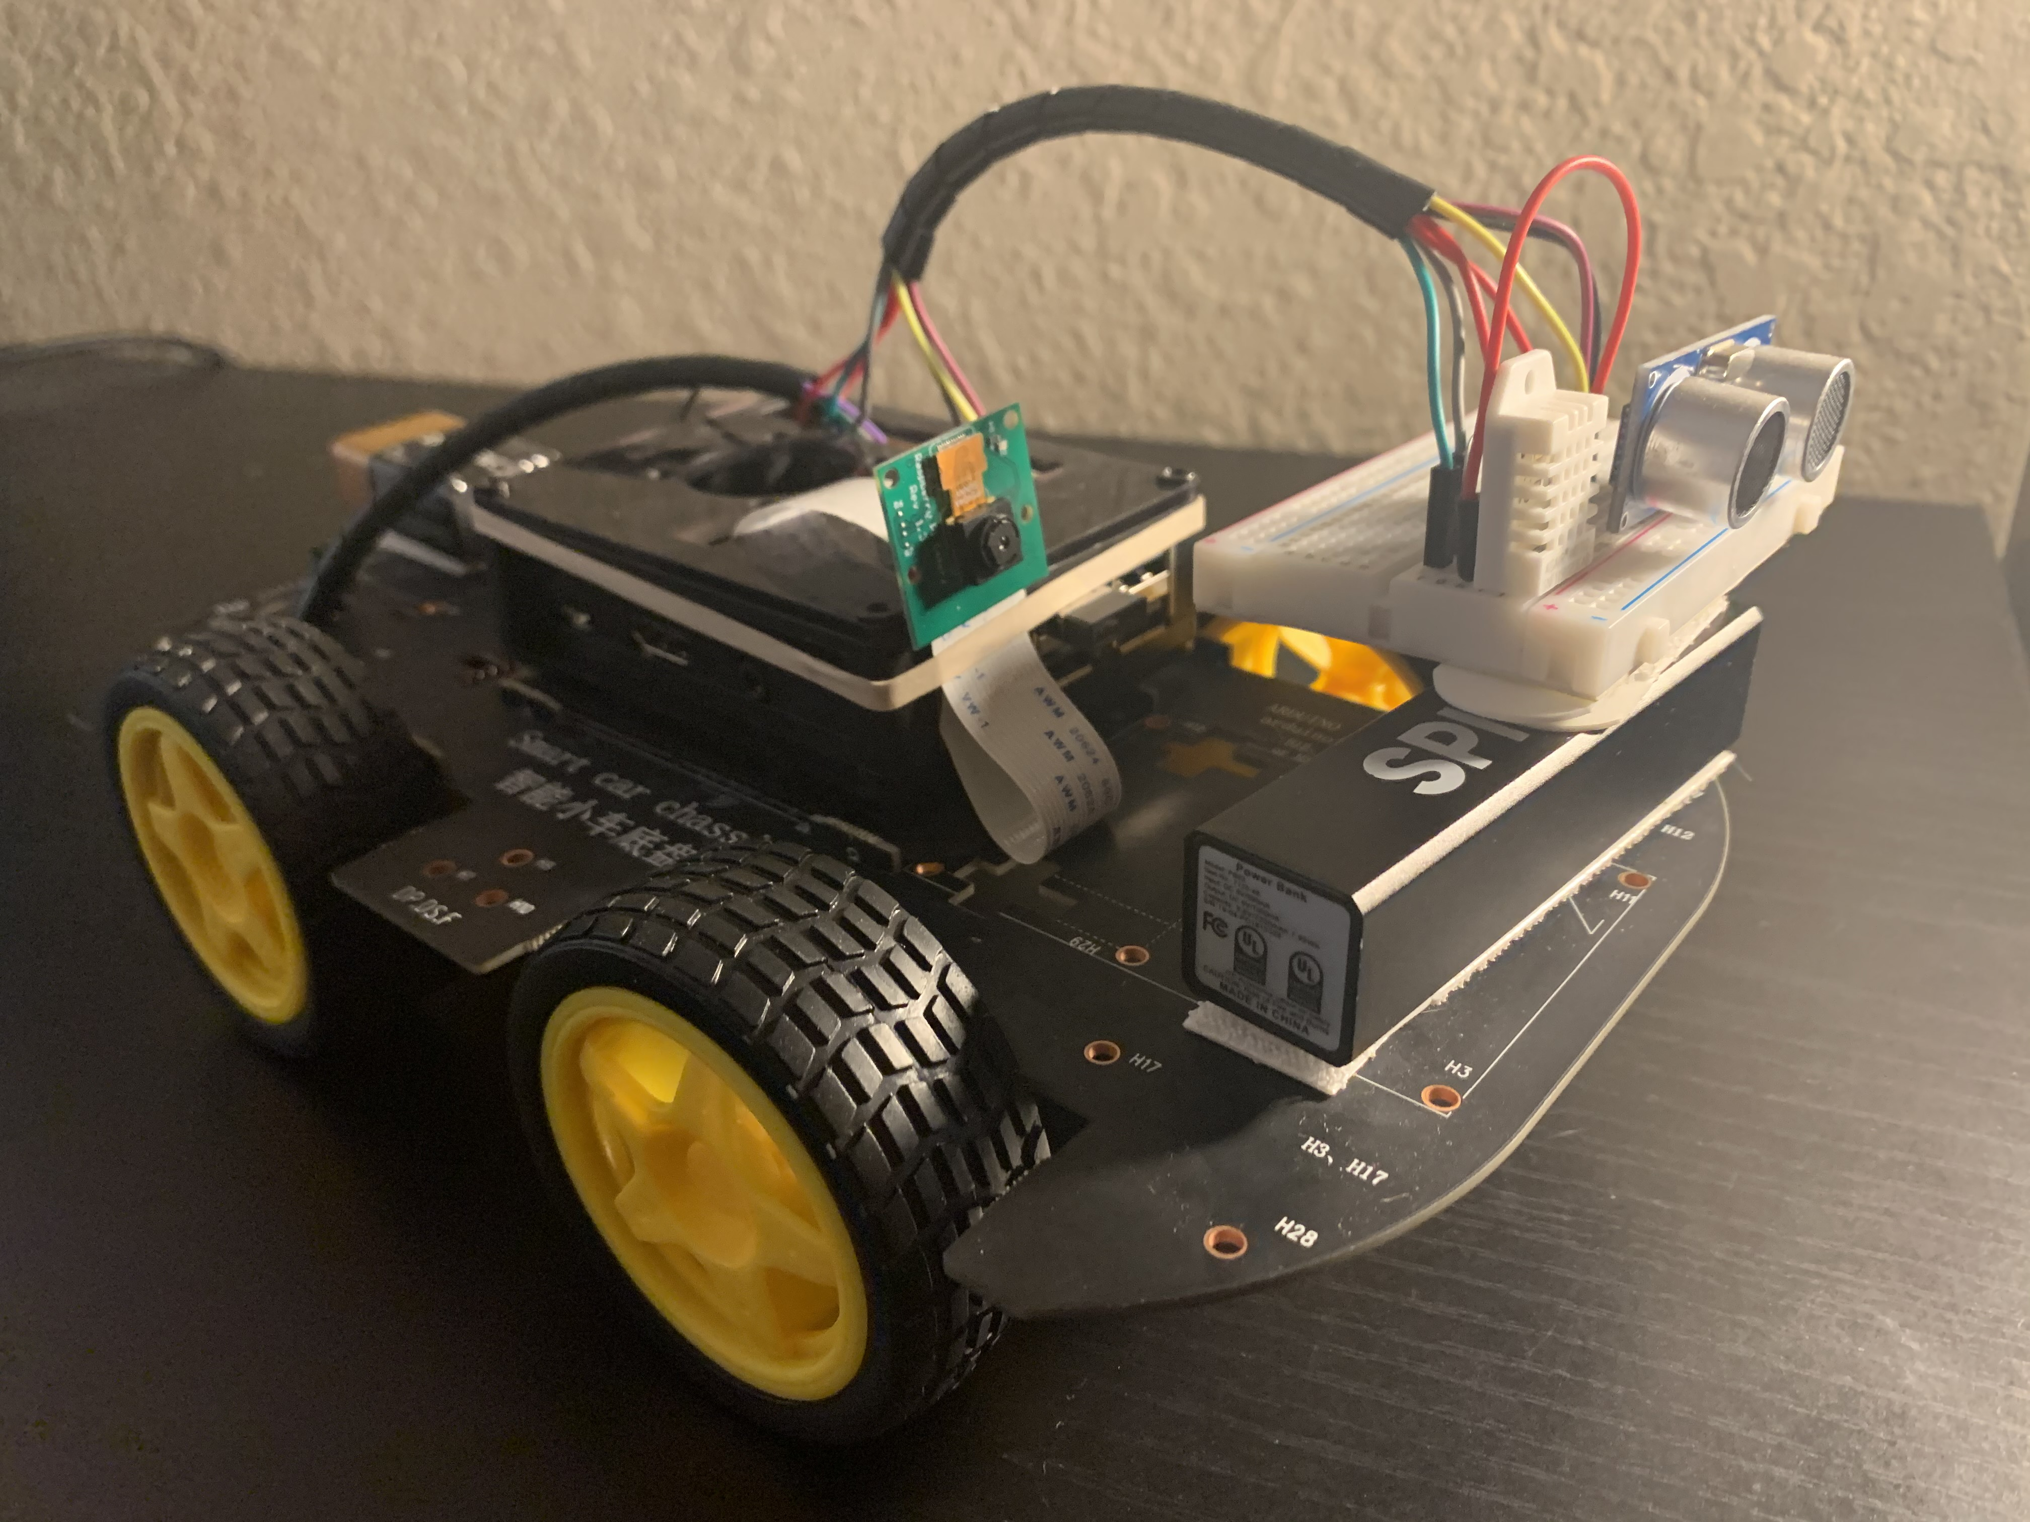
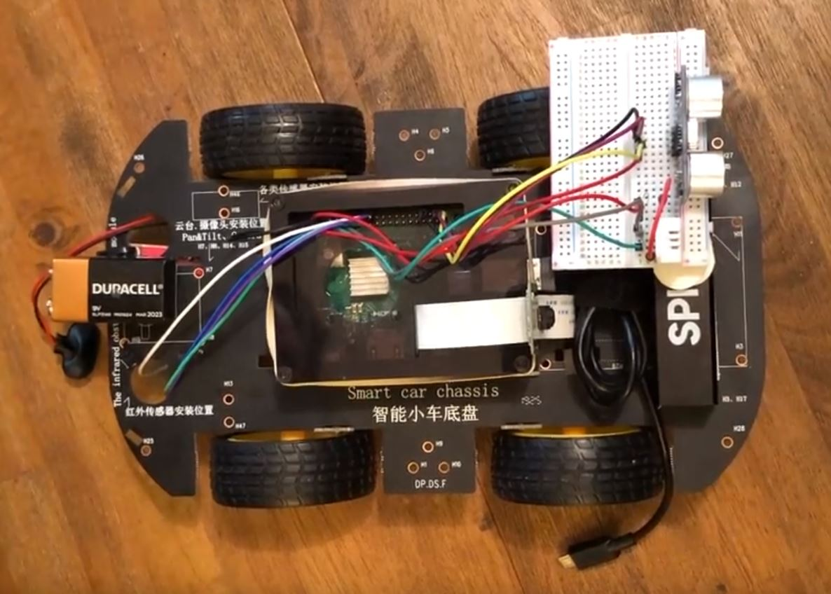
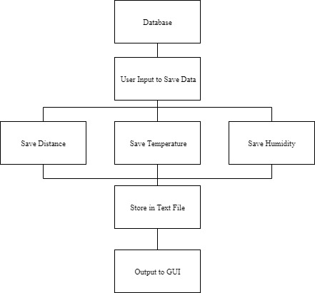
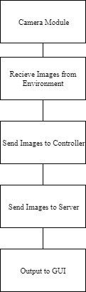
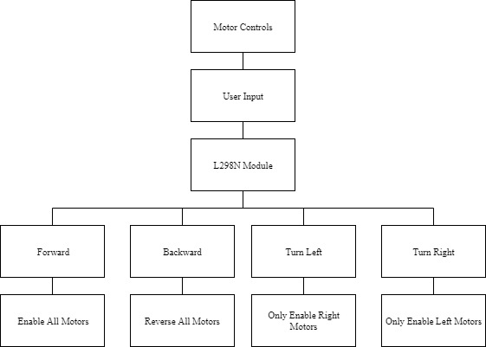
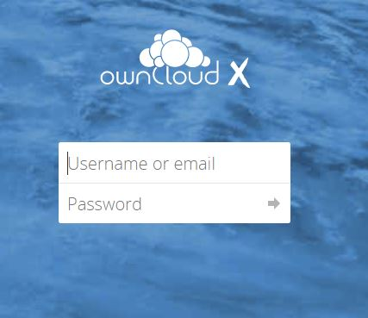
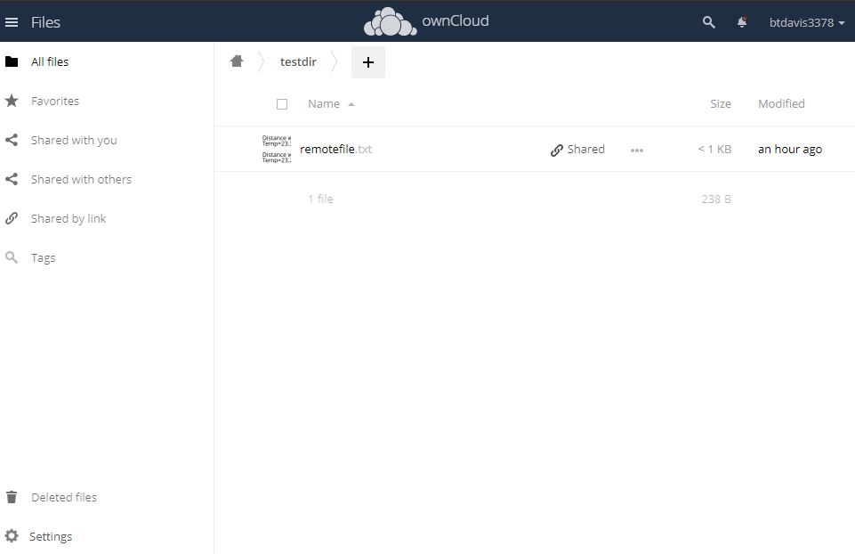
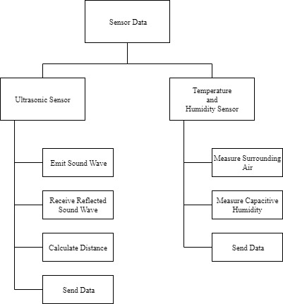
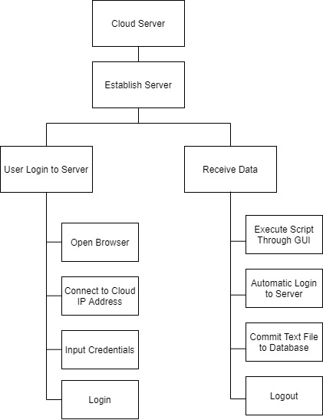
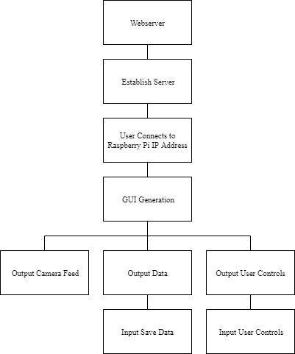
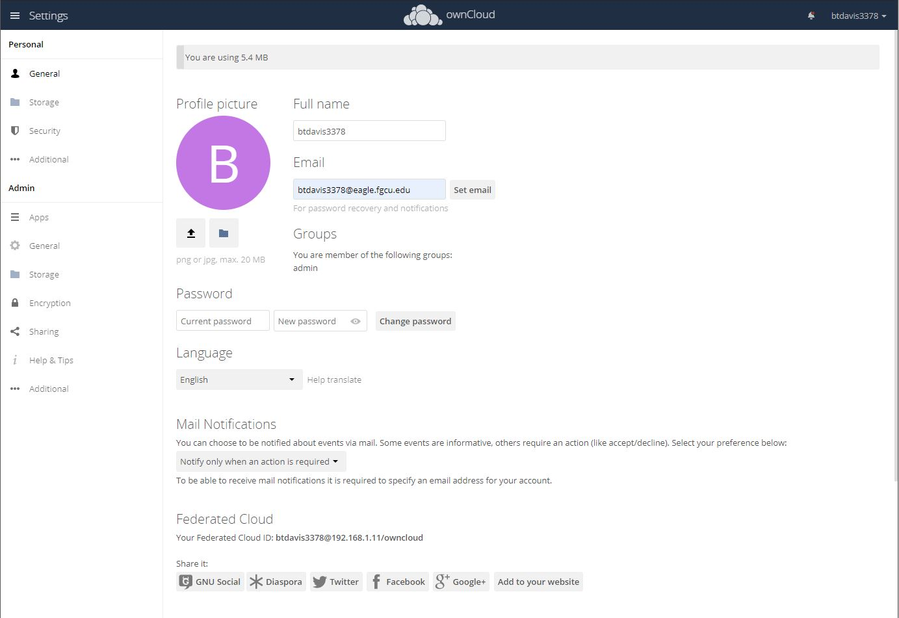
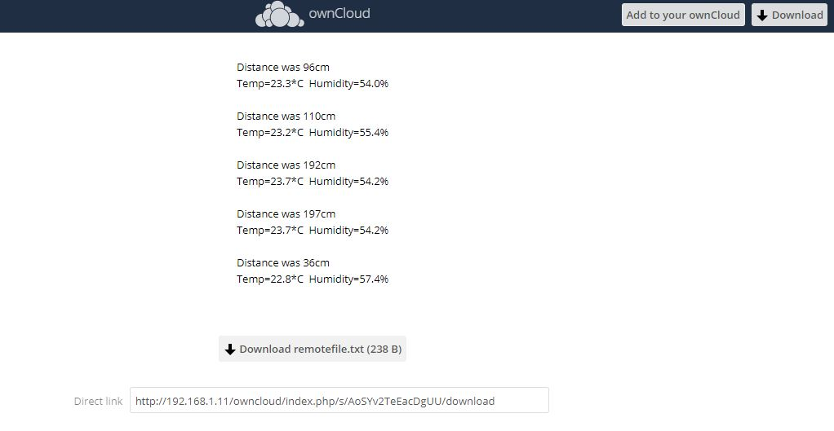
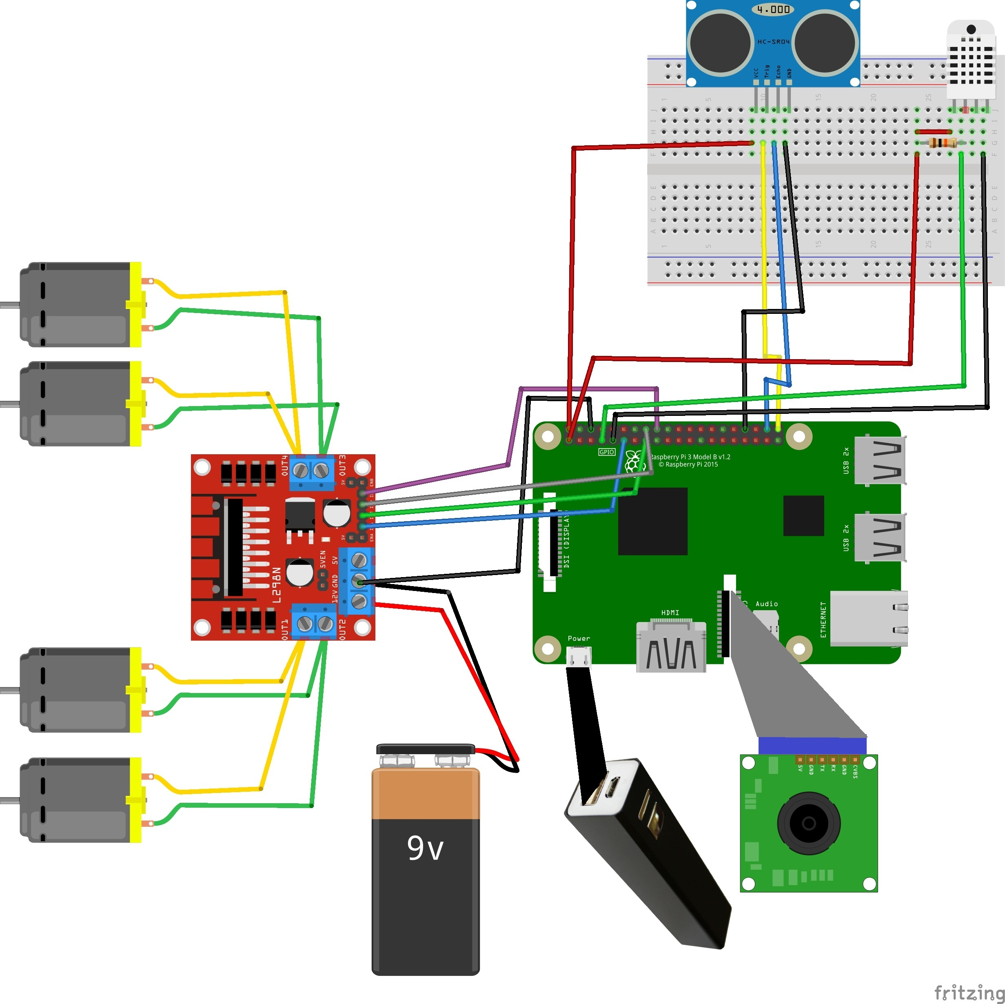
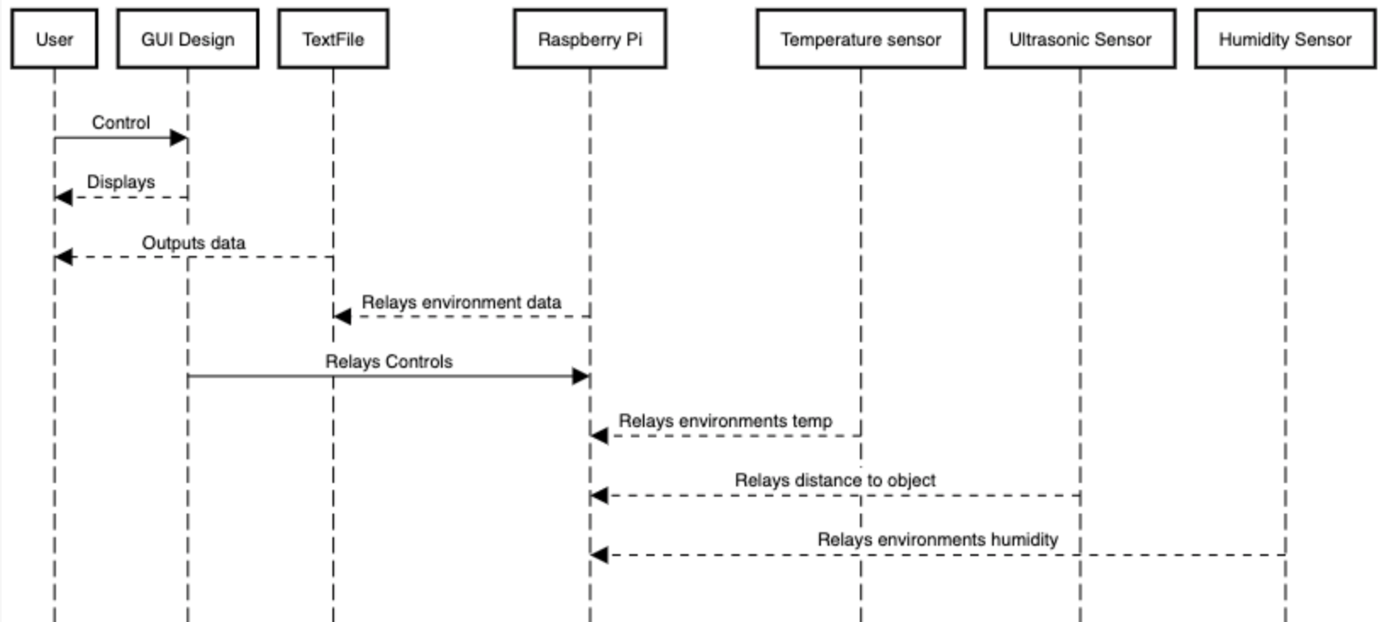



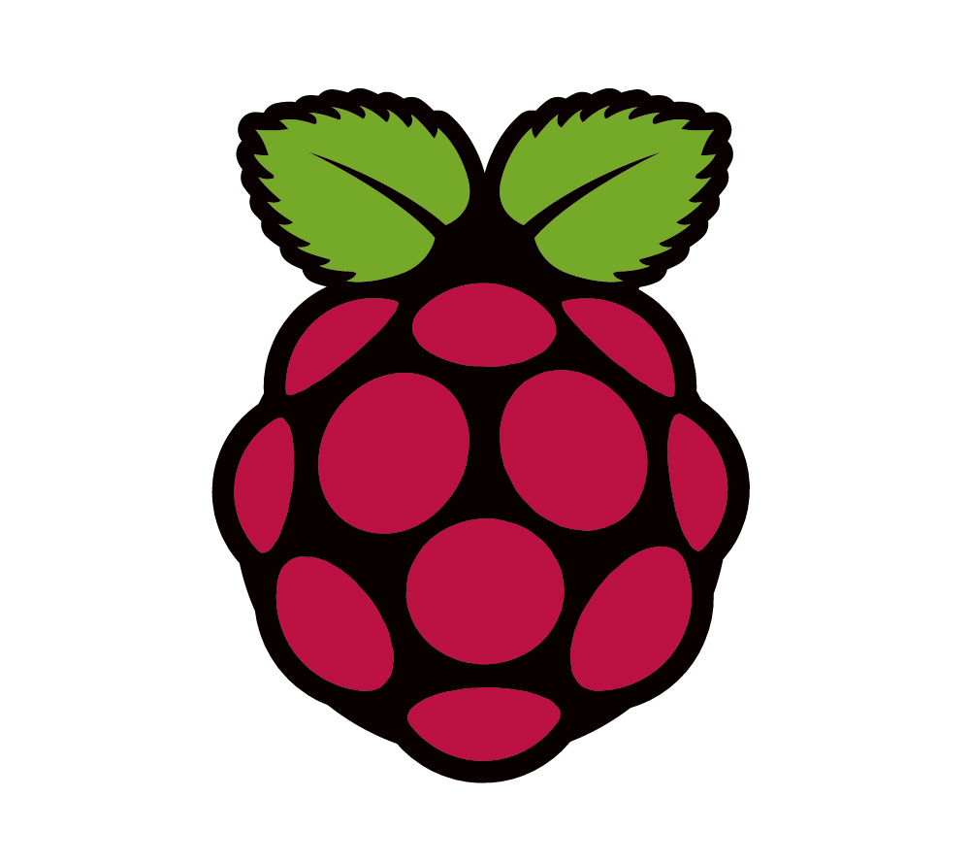
Collection and Visualization of Environmental Data with Remotely Controlled Rover
Brandon Davis and Gage Kettering
Faculty Mentor: Dr. Janusz Zalewski
Software Engineering Department, Florida Gulf Coast University, Fort Myers, FL 33965
Abstract
Design
Web Application
There has been a growing demand for data collection in remote environments. This includes environments that are unexplored, not accessible to humans, contain unknown conditions, or that are desired to be studied. Various elements from environments poses many safety concerns. Environmental conditions can be safely monitored for surface-based studies from a secure location using innovative technologies. The adopted solution for safe surface exploration is Data Acquisition Through a Car Altering Remote (DAT CAR), which is a rover that is designed to gain environmental knowledge in various areas. DAT CAR offers the ability for an individual to collect and visualize environmental data through a network connection. The user can control the rover from a remote location of their choice by having a Wi-Fi connection and the external Internet address of DAT CAR. Utilizing Flask, a micro web framework, the rover establishes a web server that the user is routed to when connecting to DAT CAR. From the Graphical User Interface (GUI), a video stream is shown of the environment in front of the rover for the user to visualize and evaluate the conditions of the surrounding area. Additionally, the GUI displays the temperature and humidity of the area and the distance of an object in front of the rover. The environmental data are relayed to a cloud server that DAT CAR will establish and connect to. The user can save environmental data and connect to the cloud server to study and evaluate the sets of data. DAT CAR was constructed through the research and study of software engineering, robotics, and networks. It was found that DAT CAR reflects innovative technologies for the use of safe exploration and the study of environments from a remote location.
Context Diagram
Physical Diagram
In an Internet browser search bar type “http://<IPAddressofPi>:5010” and hit enter. The browser connects to the webserver that the Raspberry Pi is hosting, and the GUI should display.
Features
Camera view of in front of DAT CAR
Movements: Forward, Backward, Left, and Right will alter the chassis in the respective direction
Collect Data: Updates the data currently being displayed on the GUI
Save Data: Writes current data to text files and relays it to the cloud server
Go to Cloud: Opens the webpage to the oneCloud server
DAT CAR
Structure Charts
Database
Camera
Motor controls
Cloud Server
Features
Username and password required
Access Data
Sync Data
Share Data
Encryption
Customizable
Application API
Migration and Backup
Tasks
Calendar
Gallery
LDAP / Active Directory
The final assembly of DAT CAR is shown above. The housing of the Raspberry Pi is attached to the top of the chassis. The power supply for the Raspberry Pi is also attached near the front of the chassis where it is used as a fastening point for the sensors connected to the breadboard. At the rear of the chassis is the 9v battery that is attached to the motor module. The motor module is underneath the chassis. The hardware components are connected to the Pi’s GPIO pins to receive power, grounding, and I/O.
Highlights
Controlled via web browser
Establishes cloud and web servers
Simple connectivity
Ground mobility
Camera for visualization
Ultrasonic sensor
Temperature and humidity sensor
Data version control
Startup scripts
Open-source
Modifiable
Sensors
Cloud
Webserver
Circuit Diagram
Software Behavior
Hardware Components
Raspberry Pi 3 B+
Ultrasonic Sensor (HC-SR04)
Temperature/Humidity Sensor (DHT22)
10K Ω Resistor
Breadboard
Motor Module (L298N Duel H-Bridge)
4 DC TT Biaxial Motors
Power Supply Stick
9v Battery with Snap Connector
Raspberry Pi Camera Module V2-8 Megapixel, 1080p
Other Components not in Diagram
Raspberry Pi Case
SD Card
Smart Car Chassis
4 Rubber Wheels
Screws
Rubber Band
Wire Holders
Velcro Strips
Zip Ties
Sequence Diagram
Conclusion
DAT CAR was constructed through the research and study of software engineering, robotics, and networks. It was found that DAT CAR reflects innovative technologies for the use of safe exploration and the study of environments from a remote location. However, there are many discrepancies that are currently ongoing with the device. The cloud service for DAT CAR is currently being worked on. In its current state, there is functionality with the cloud services, but it is unrefined and is in a state that is desired to be improved. There are also issues with security if port forwarding is the medium of choosing to control DAT CAR from another network. Port forwarding exposes a network port on one’s private LAN to the public internet. This is a known security vulnerability and must be managed carefully.
There are also multiple suggestions to add on to the project. A way to move the DAT CAR camera vertically and horizontally is a desired functionality. As of right now, the DAT CAR can spin itself in a circle to see its surroundings, however, if the car was to stay stationary and revolve its camera, then this would allow for the system to acquire data surrounding the car without having to spin the chassis. Adding this would be extremely helpful if DAT CAR was in a potentially dangerous spot. For instance, if the rover was on the edge of a cliff. Additionally, it was found that there is risk involved with the hull integrity and battery life of the motor module. Improvements to the hull and battery life would drastically enhance DAT CAR.
Languages
Tools
Statistics
Python3
JavaScript
HTML
PhP
Raspbian OS
ownCloud
Flask
Apache2
4 essential files
~350-400 lines of code
Cost: ~$140.00
Motor Battery life: 1h
Power Supply Life: 5h
Camera Resolution: 320x240

